Slide 1
Parallel Implementations of Ensemble Kalman Filters for Huge Geophysical Models Jeffrey Anderson, Helen Kershaw, Jonathan Hendricks, Nancy Collins, Ye Feng NCAR Data Assimilation Research Section

Slide 2


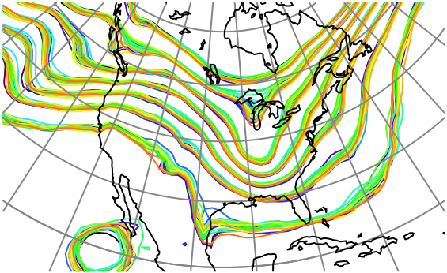
What is Data Assimilation?
Observations combined with a Model forecast…
+
…to produce an analysis (best possible estimate).

Slide 3
The Data Assimilation Research Testbed (DART)
DART provides data assimilation ‘glue’ to build state-of-the-art ensemble forecast systems for even the largest models.
Prediction Model
Observing System
DART
Analysis

Slide 4
DART Goals
Provide State-of-the-Art Data Assimilation capability to:
Prediction research scientists,
Model developers,
Observation system developers,
Who may not have any assimilation expertise.

Slide 5
DART Design Constraints
Models small to huge.
Few or many observations.
Tiny to huge computational resources.
Entry cost must be low.
Competitive with existing methods for weather prediction:
Scientific quality of results,
Total computational effort must be competitive.

Slide 6
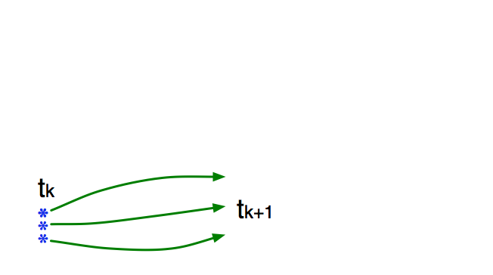
How an Ensemble Filter Works for Geophysical Data Assimilation
Use model to advance ensemble (3 members here) to time at which next observation becomes available.
Ensemble state estimate after using previous observation (analysis)
Ensemble state at time of next observation (prior)

Slide 7
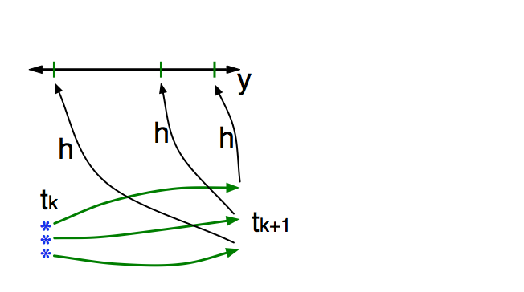
How an Ensemble Filter Works for Geophysical Data Assimilation
Get prior ensemble sample of observation, y = h(x), by applying forward operator h to each ensemble member.
Theory: observations from instruments with uncorrelated errors can be done sequentially.

Slide 8
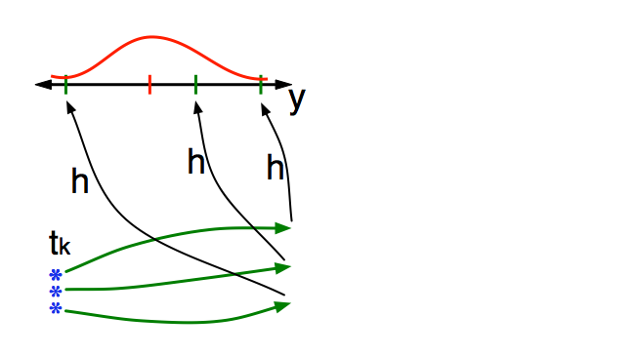
How an Ensemble Filter Works for Geophysical Data Assimilation
Get observed value and observational error distribution from observing system.

Slide 9
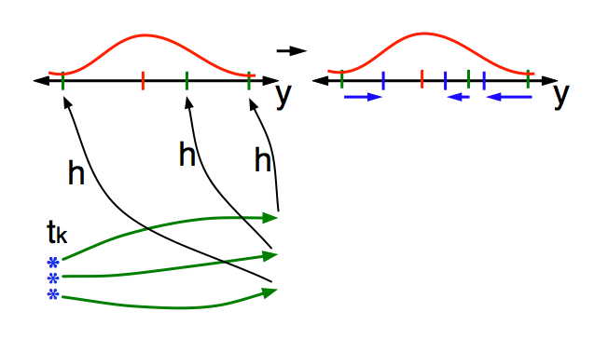
How an Ensemble Filter Works for Geophysical Data Assimilation
Find the increments for the prior observation ensemble (this is a scalar problem for uncorrelated observation errors).

Slide 10
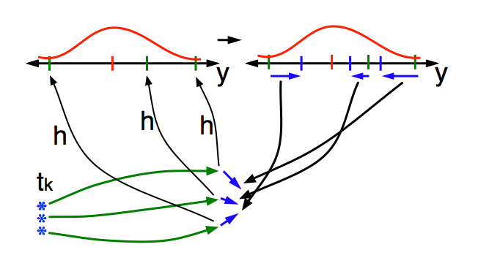
How an Ensemble Filter Works for Geophysical Data Assimilation
Use ensemble samples of y and each state variable to linearly regress observation increments onto state variable increments.

Slide 11
How an Ensemble Filter Works for Geophysical Data Assimilation
Use ensemble samples of y and each state variable to linearly regress observation increments onto state variable increments.
Theory: impact of observation increments on each state variable can be handled independently!

Slide 12
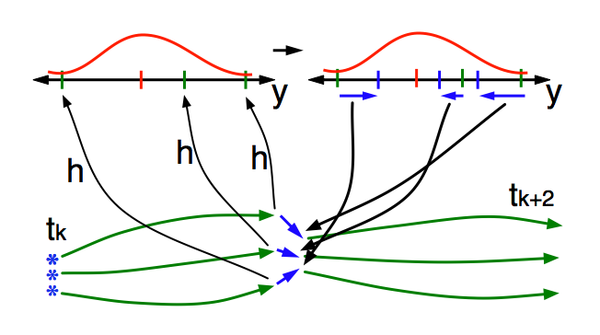
How an Ensemble Filter Works for Geophysical Data Assimilation
When all ensemble members for each state variable are updated, integrate to time of next observation …

Slide 13
How an Ensemble Filter Works for Geophysical Data Assimilation
For large models, regression of increments onto each state variable dominates time.

Slide 14
Parallelizing Implementation of the Regression
Data layout (option 1):
Each process stores all ensemble copies of subset of state.
Simple example:
4 Ensemble members;
4 PEs (colors).
Observation shown by red star.

Slide 15
Parallelizing Implementation of the Regression
Data layout (option 1):
Each process stores all ensemble copies of subset of state.
One PE broadcasts obs. increments.
All ensemble members for each state variable are on one PE.
Can compute state mean, variance without communication.
All state increments computed in parallel.

Slide 16
Computing Forward Operators
Data layout (option 1):
Each process stores all ensemble copies of subset of state.
Computing forward operator, h, is often local interpolation.
Most observations require no communication.
Those near boundaries or more complex operators require communication.

Slide 17
Load Balancing Issues for Regression with Localization
Data layout (option 1):
Each process stores all ensemble copies of subset of state.
Observation impact usually localized, reduces errors.
Observation in N. Pacific not expected to change Antarctic state.
PE4 lots of work, PE1 has none.

Slide 18
Load Balancing Issues for Regression with Localization
Data layout (option 2):
Each process stores all ensemble copies of subset of state.
Can balance load by ‘randomly’ assigning state variables to PEs.

Slide 19
Load Balancing Issues for Regression with Localization
Data layout (option 2):
Each process stores all ensemble copies of subset of state.
Can balance load by ‘randomly’ assigning state variables to PEs.
Now computing forward operators, h, requires communication.

Slide 20
Eliminating Communication for Forward Operators
Data layout (option 3):
Entire state for each ensemble on single PE.
If each PE has a complete ensemble, forward operators require no communication.

Slide 21
Eliminating Communication for Forward Operators
Data layout (option 3):
Entire state for each ensemble on single PE.
If each PE has a complete ensemble, forward operators require no communication.
Many forward operators could be done at once.

Slide 22
Best of Both Worlds? Using a Data Transpose.
Two Data layouts:
Option 2 for regression, Option 3 for forward operators
Do a data transpose between options 3 and 2, using all to all communication.
Then do state increments for each observation sequentially.

Slide 23
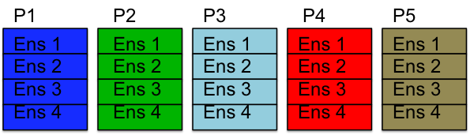
Best of Both Worlds? Using a Data Transpose.
Two Data layouts:
Option 2 for regression, Option 3 for forward operators
P1
P2
P3
P4
ENS1
ENS2
ENS3
ENS4
All copies of some variables available to a single processor
Whole model state available to a single processor.

Slide 24
Problems with Using a Data Transpose.
Lots of communication, have to move all the data.
Not memory scalable, whole state must fit on a PE.
Load balancing for forward operators.
P1
P2
P3
P4
Ensemble size 4 example.
4 tasks have a whole copy of the model state.
ENS1
ENS2
ENS3
ENS4
Other tasks have no data and nothing to do during forward operators.
P5
P6
P7
P8
P9
P10
P11

Slide 25
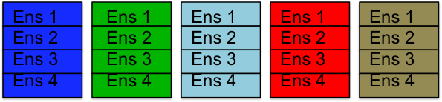
Avoiding the Transpose: Forward Operators with Distributed State
Use MPI2 one sided communication to grab state elements for forward operators.
Reduces data movement.
Removes hard memory limit.
P1 P2 P3 P4 P5
Allows Vectorization of forward operator calculations.

Slide 26
MPI2 One Sided Communication
Have my process and a set of other processes.
Me

Slide 27
MPI2 One Sided Communication
Have my process and a set of other processes.
Me
Everyone Else

Slide 28
MPI2 One Sided Communication
Can place any of my data in a virtual window.
Me
Everyone Else
window

Slide 29
MPI2 One Sided Communication
Any other task can asynchronously grab data in ‘window’.
Me
Everyone Else
window

Slide 30
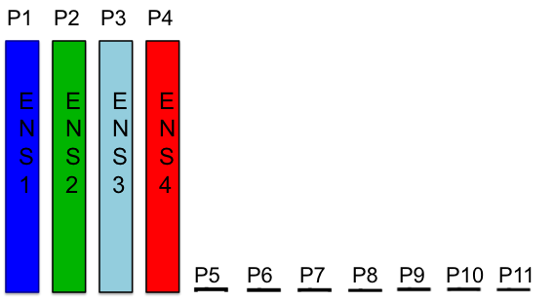
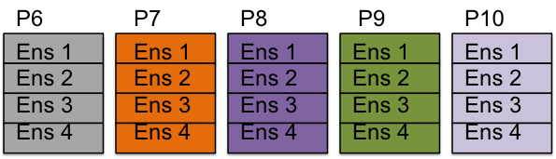
MPI2 One Sided Communication
Memory scales for forward operators; allows large models. Computation of forward operators also scales and balances.
New: Lots of tasks doing some observations for all copies. Vectorizes, too.
Old: 4 tasks doing all observations for 1 copy.

Slide 31
WRF (regional weather forecast model) Results
Example problem specification:
184 million model state variables
1.5 GB per ensemble member
50 Ensemble members
O(100,000) observations

Slide 32
WRF (regional weather forecast model) Results
Hardeware specification:
NCAR’s Yellowstone:
Intel Sandybridge
16 cores per node
25 GB usable memory per node

Slide 33
WRF Results: Memory Scaling
Old
Average GB/Node
New
2 4 8 16 32 64 128 256
Number of Nodes
Original DART 8 tasks/node max.
New (RMA) version memory scales far better.

Slide 34
WRF Results: Computational Scaling for Assimilation
Old 8 tasks/node
New 8 tasks/node
New 16 tasks/node
Time (seconds)
1 2 4 8 16 32 64 128 256
Number of Nodes
Very similar with 8 tasks per node.
New with 16 tasks/node slightly slower (memory overhead)

Slide 35
WRF Results: Bonus, I/O Scaling Improves
Old 8 tasks/node
New 8 tasks/node
New 16 tasks/node
Total time scales much better for new (RMA).
Almost all due to writing separate output from each node.
Not gathering and doing single write.

Slide 36
Making Effective Use of Coprocessors
Focus on Specific Routines with Favorable Characteristics:
High number of floating point instructions,
Reasonably high floating point instructions per load/store,
Isolated code – each process works on its own local data,
Can develop on one node, but apply to multinode runs.
Notes:
floating point instructions per load/store ~= 2.5. This is not that high, but it is the highest we have.

Slide 37
Example: subroutine get_close
Making Effective Use of Coprocessors
For a given observation computes:

Slide 38
Example: subroutine get_close
Making Effective Use of Coprocessors
For a given observation computes:
Number of state variables (or obs) within the localization radius,
Distances to close state variables,
Indices of the close states.

Slide 39
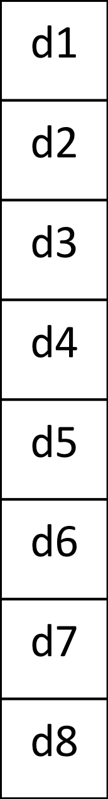
Making Effective Use of Coprocessors
GPU Algorithm for get_close:
Implemented in CUDA Fortran for NVIDIA GPUS by Ye Feng
1
2
Thread
3
Each thread calculates a distance
4
5
6
7
8
id
dist
Key idea for GPU implementation reduce branching.
Notes:
maxdist is cut off

Slide 40
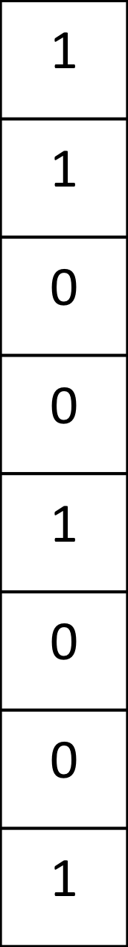
Making Effective Use of Coprocessors
GPU Algorithm for get_close:
1
2
Thread
3
1, dist<cutoff (close)
Most Significant Bit of (dist – cutoff)
4
0, dist>cutoff (not close)
5
6
7
8
id
dist
diff
Key idea for GPU implementation reduce branching
Notes:
maxdist is cut off

Slide 41
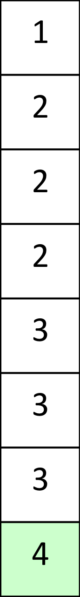
Making Effective Use of Coprocessors
GPU Algorithm for get_close:
1
2
Thread
3
Prefix Sum of diff
4
5
6
7
8
Last element gives number of close obs
id
dist
diff
sum
Key idea for GPU implementation reduce branching
Notes:
maxdist is cut off

Slide 42
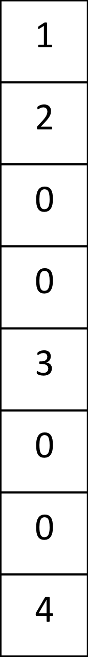
Making Effective Use of Coprocessors
GPU Algorithm for get_close:
1
2
Thread
3
4
diff x sum
5
6
7
8
id
dist
diff
sum
diff
sum
Key idea for GPU implementation reduce branching
Notes:
maxdist is cut off

Slide 43
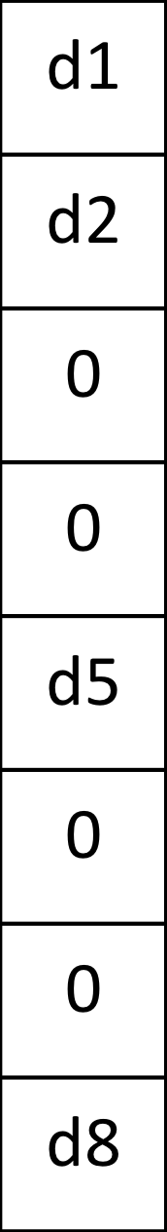
Making Effective Use of Coprocessors
GPU Algorithm for get_close:
1
2
Thread
3
4
diff x dist
5
6
7
8
id
dist
diff
sum
diff
sum
close dist
Key idea for GPU implementation reduce branching
Notes:
maxdist is cut off

Slide 44
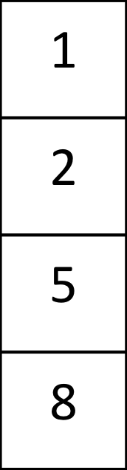
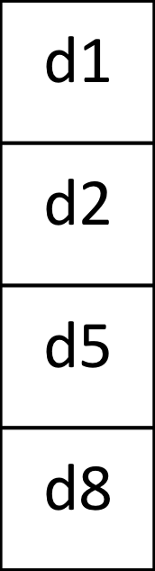
Making Effective Use of Coprocessors
GPU Algorithm for get_close:
1
2
Thread
3
4
5
observation
index
distance
6
7
8
id
dist
diff
sum
diff
sum
close dist
Key idea for GPU implementation reduce branching
Notes:
maxdist is cut off

Slide 45
Making Effective Use of Coprocessors
GPU Algorithm for get_close:
output index
1
2
Thread
3
4
5
observation
index
distance
6
7
8
id
dist
diff
sum
diff
sum
close dist
Key idea for GPU implementation reduce branching
Notes:
maxdist is cut off

Slide 46
Making Effective Use of Coprocessors
Notes:
(si=1,sn=1) . Si Sn are parameters to tune si=1 sn = 1 is the worse case scenario of no tuning. Speed up includes the data transfer. For production code the observation locations only need to be loaded once.

Slide 47
Conclusions
General purpose ensemble filters can scale well to many processes.
Large geophysical problems can scale easily to O(10000) processes.
General purpose facility must support flexible data distribution.
IO is fast becoming the biggest bottleneck.
Efficient use of coprocessors may be possible.
A parallel implementation simulation facility is useful.

Slide 48



Learn more about DART at:
www.image.ucar.edu/DAReS/DART
dart@ucar.edu
Anderson, J., Hoar, T., Raeder, K., Liu, H., Collins, N., Torn, R., Arellano, A., 2009: The Data Assimilation Research Testbed: A community facility.
BAMS, 90, 1283—1296, doi: 10.1175/2009BAMS2618.1

